Slide 1
AMAZON
USA
PRODUCT NAME
WRIST REST
TOP 10 COMPETITOR ANALYSIS

Slide 2
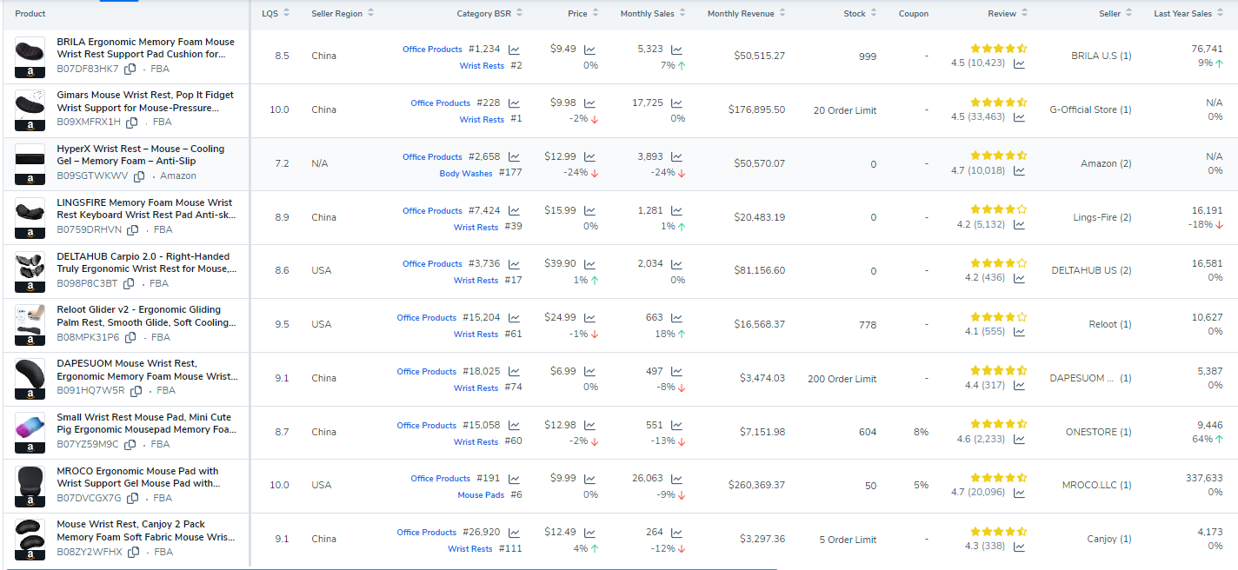
TOP 10 COMPETITORS DATA COMPERISON

Slide 3
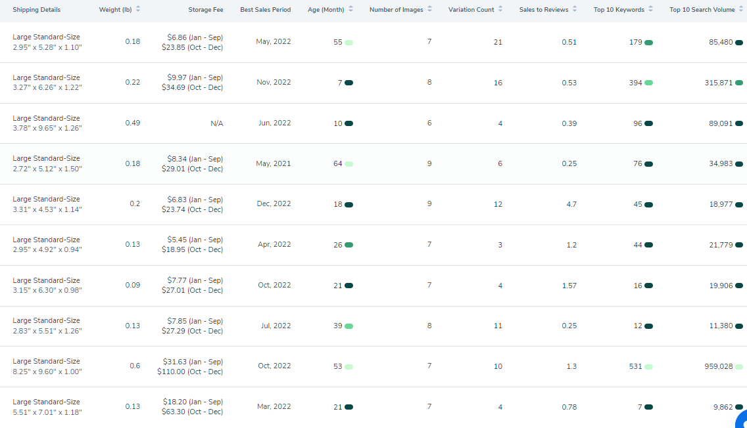
MORE DETAILS

